Slide 1

Music Store Management System

Slide 2
INTRODUCTION :
The Music Store Data Analysis project focuses on analysing a relational music store database using SQL to solve real-world business problems. It involves exploring customer behaviour sales performance, and music preferences through structured queries. By applying SQL concepts such as joins, aggregations, subqueries, and window functions, the project transforms raw data into meaningful business insights. This analysis helps support data-driven decision-making and strengthens practical database and analytical skills.

Slide 3
BUSINESS SOLVING PROBLEM :
What is the distribution of customers across different purchasing segments, and what marketing strategy should be applied to each segment and increase in revenue?

Slide 4
Agenda
Objective of the Project
Key analysis questions (use cases)
Conclusion (Key finding overall)
Q&A Slide
Your Experience/Challenges working

Slide 5
Objective of the Project:
Analyze customer purchasing behavior.
Identify high-value customers using Customer Lifetime Value (CLV).
Detect customers at risk of churn.
Identify countries suitable for business expansion.
Analyze product (track, album, and genre) performance.
Evaluate playlist effectiveness.
Identify revenue concentration using Pareto Analysis.
Assess artist performance and business dependency.

Slide 6
Key Analysis Questions:
1. Which Genres Are Losing Popularity?
2. Which Artists Are No Longer Generating Revenue?
3. Which Countries Have the Lowest Purchases?
4. Which Albums Have Become Dead Inventory?
5. Which Artists Should Receive New Contracts?

Slide 7
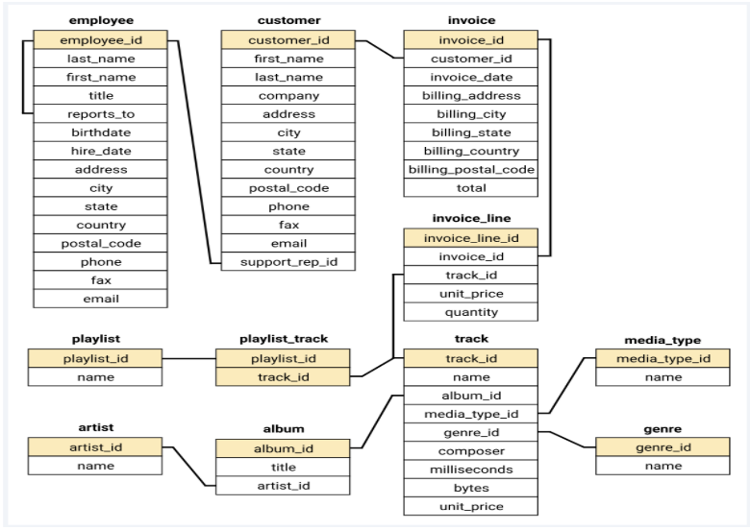
Schema Diagram :

Slide 8
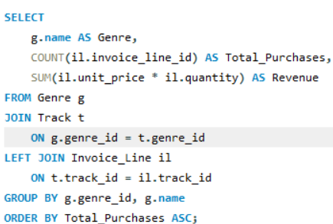
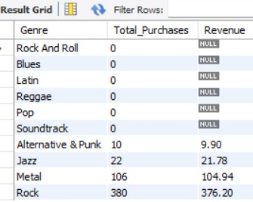
1. Which Genres Are Losing Popularity?
Query :
Output :

Slide 9
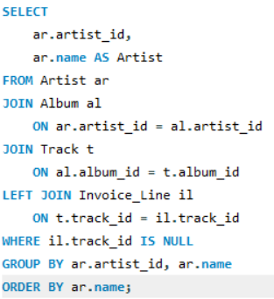
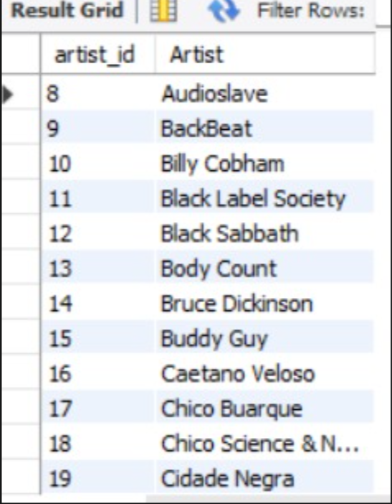
2. Which Artists Are No Longer Generating Revenue?
Query :
Output :

Slide 10
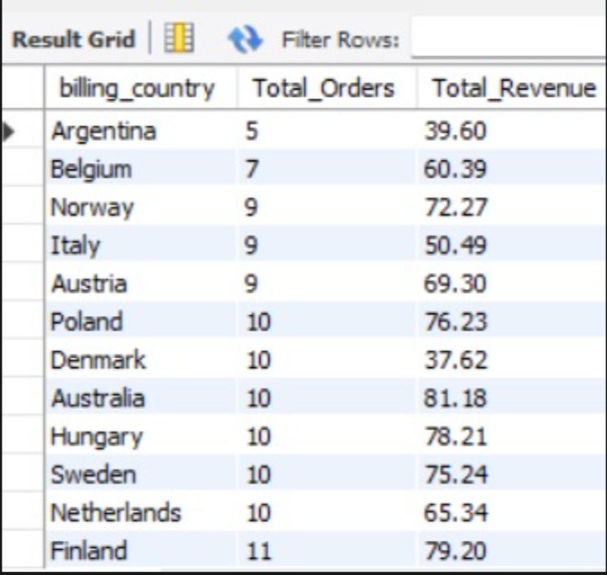
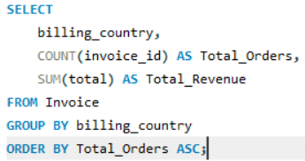
3.Which Countries Have the Lowest Purchases?
Query :
Output :

Slide 11
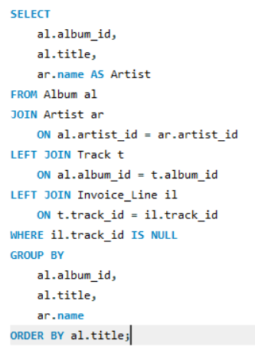
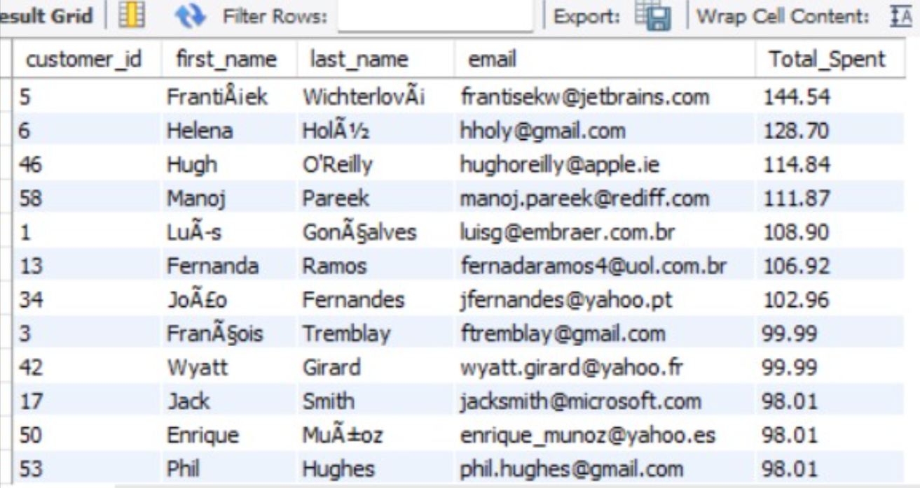
4. Which Albums Have Become Dead Inventory?
Query :
Output :

Slide 12
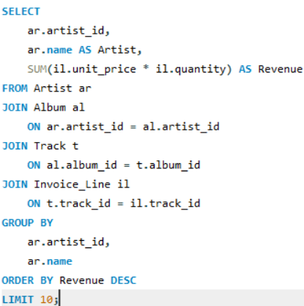
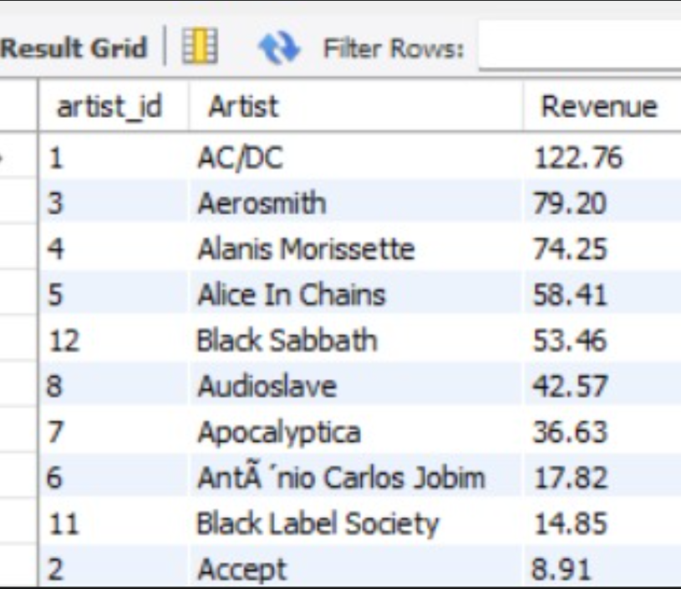
5. Which Artists Should Receive New Contracts?
Query :
Output :

Slide 13
Conclusion:-
This project demonstrated how Advanced SQL can be used to solve real business problems using the Chinook database. Instead of generating simple reports, the analysis focused on supporting strategic business decisions such as identifying high-value customers, selecting countries for business expansion, analyzing customer purchasing behavior, optimizing product performance, and improving marketing strategies.
By applying advanced SQL concepts such as Common Table Expressions (CTEs), Window Functions, CASE expressions, Aggregate Functions, Subqueries, and Joins, meaningful insights were extracted from transactional data. These insights can help management allocate marketing budgets more effectively, improve customer retention, optimize the product catalog, and support data-driven decision-making.
Overall, this project highlights the importance of SQL as a powerful analytical tool for transforming raw business data into actionable insights.

Slide 14
Our Experience / Challenges Working
Understanding the Database Schema
Identifying Real Business Problems
Writing Advanced SQL Queries
Designing business-oriented SQL queries.
Working with relational database schemas and table relationships
Using advanced SQL features such as CTEs, Window Functions (RANK, DENSE_RANK, ROW_NUMBER, NTILE), CASE expressions, and aggregate functions.

Slide 15

THANK YOU

